Slide 1
Analysis of Algorithms
Lecture 2

Slide 2
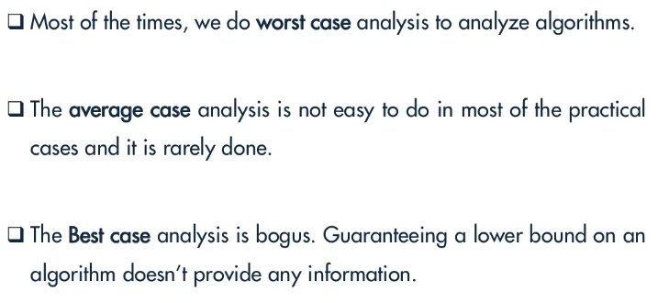
Time Complexity

Slide 3
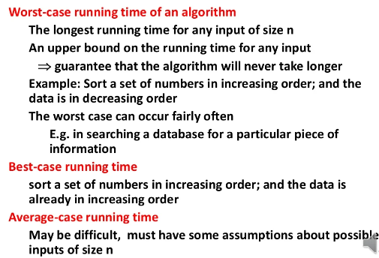

Slide 4
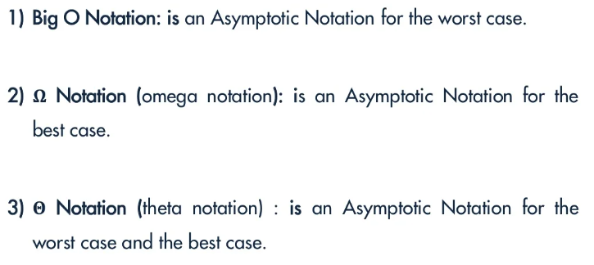
Asymptotic Notations

Slide 5
Big O Notation

Slide 6
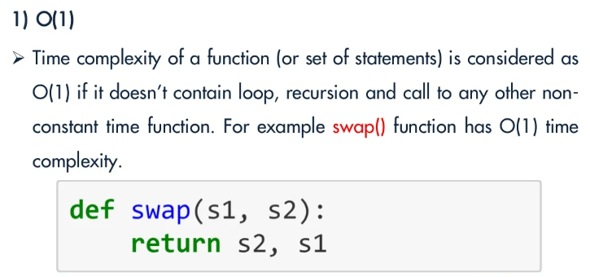
Big O Notation

Slide 7
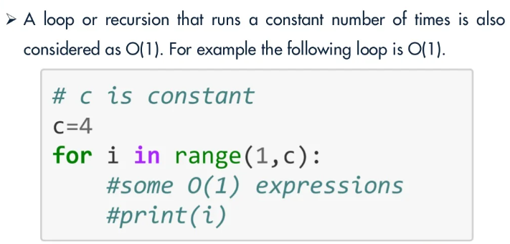
Big O Notation

Slide 8
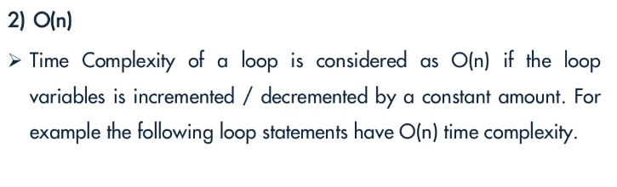
Big O Notation

Slide 9
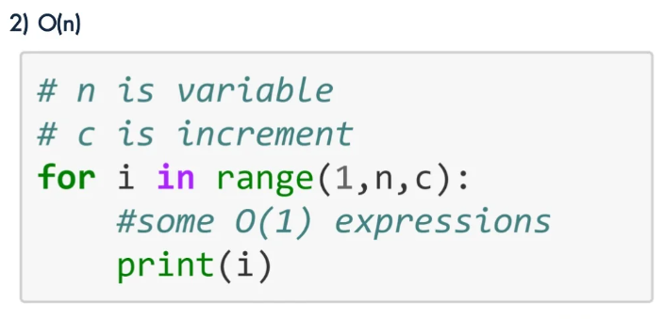
Big O Notation

Slide 10
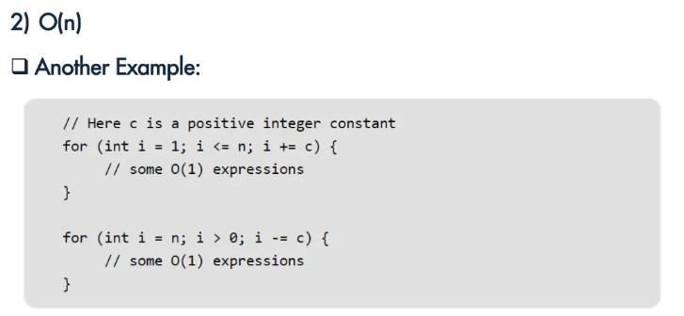
Big O Notation

Slide 11
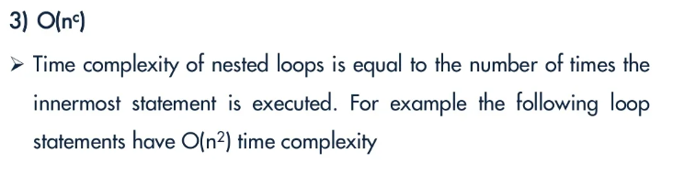
Big O Notation

Slide 12
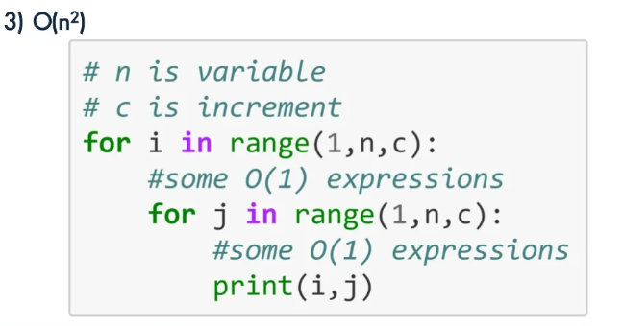
Big O Notation

Slide 13
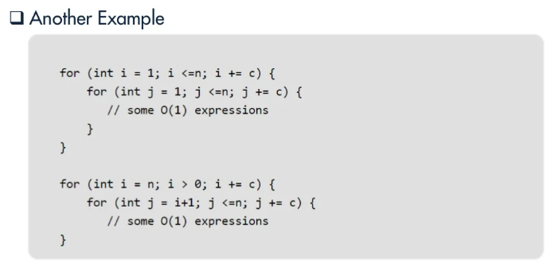
Big O Notation

Slide 14
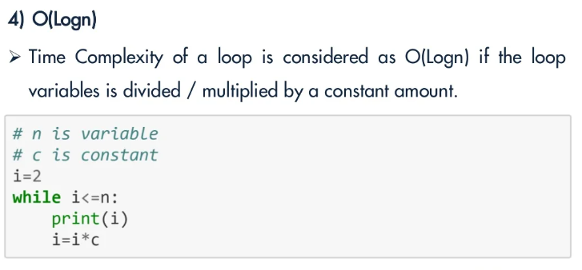

Slide 15
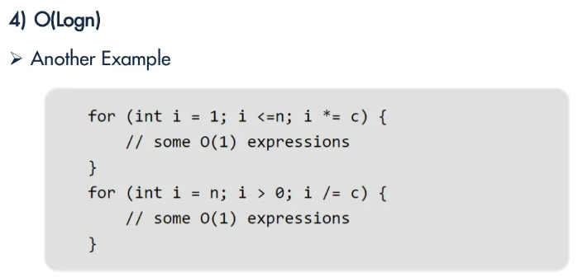

Slide 16
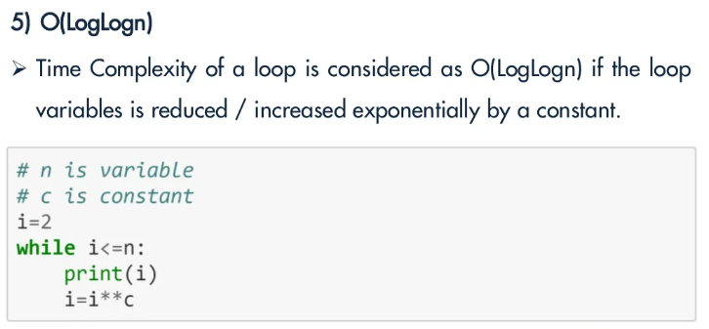

Slide 17
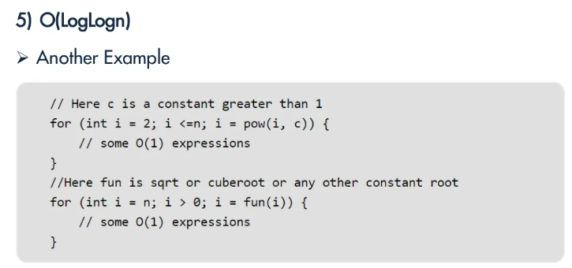

Slide 18
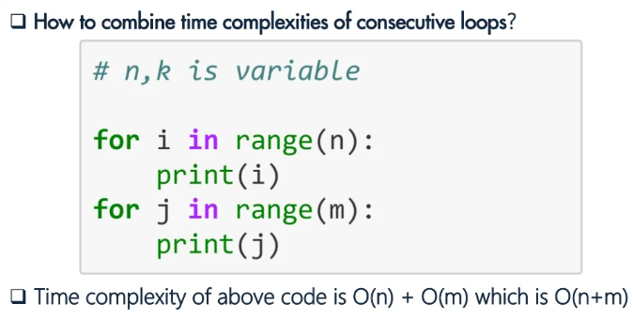

Slide 19
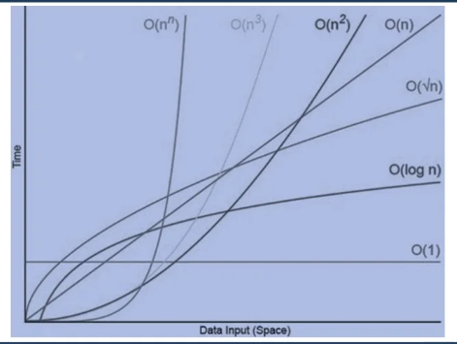
Growth Orders

Slide 20
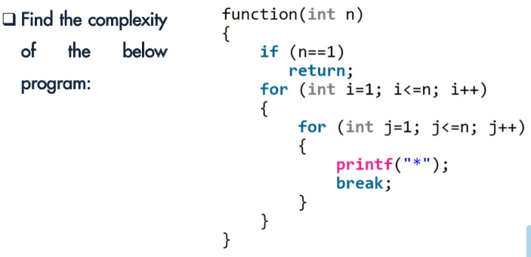
Problem

Slide 21
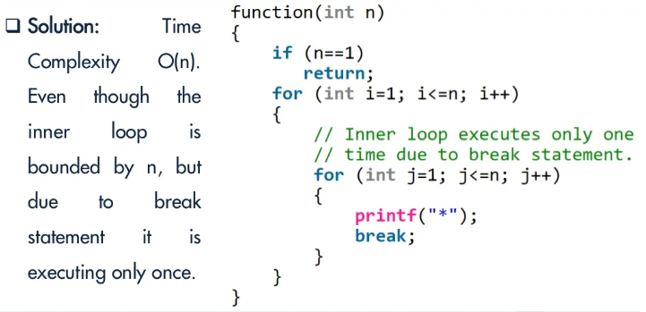
Problem

Slide 22
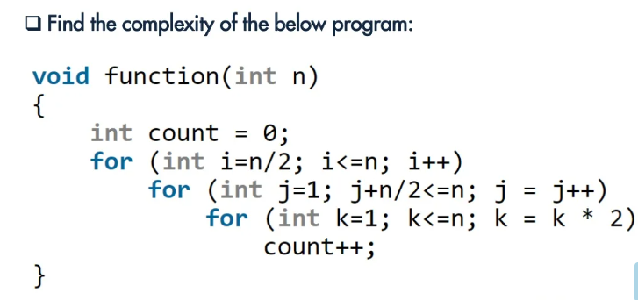

Slide 23
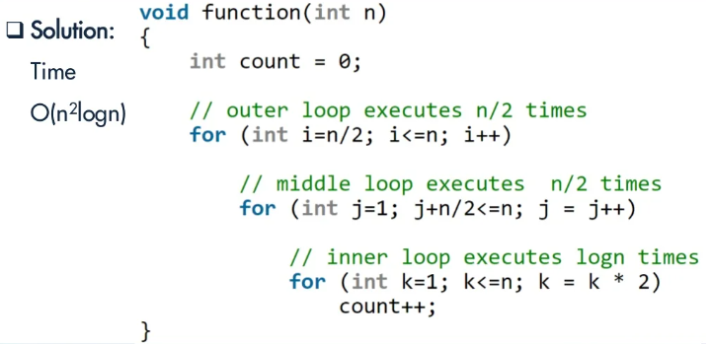

Slide 24
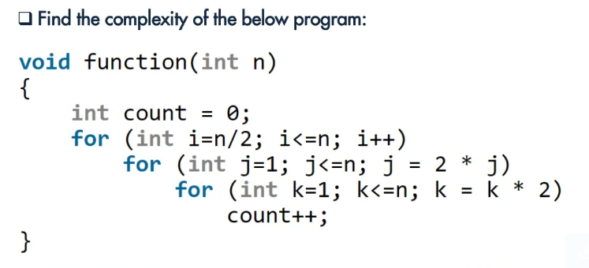
Problem

Slide 25
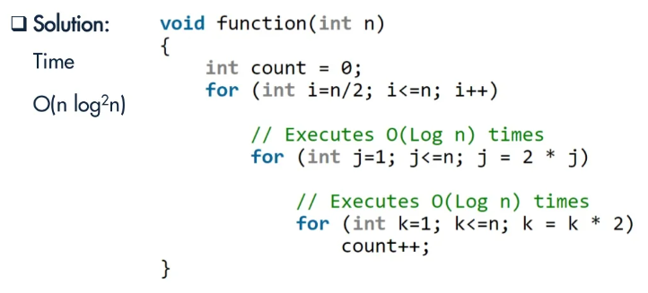

Slide 26
Sorting Algorithms Analysis

Slide 27
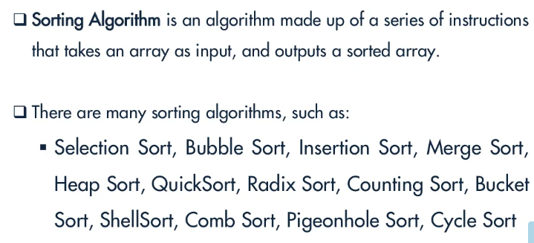
Sorting Algorithms

Slide 28
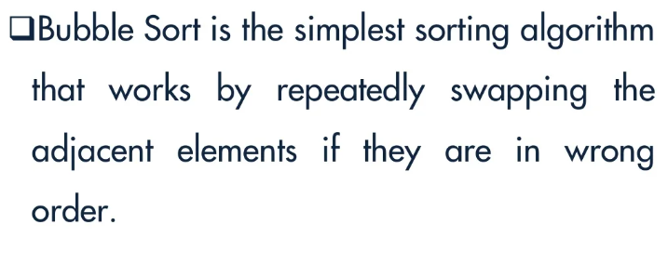
Bubble Sort

Slide 29
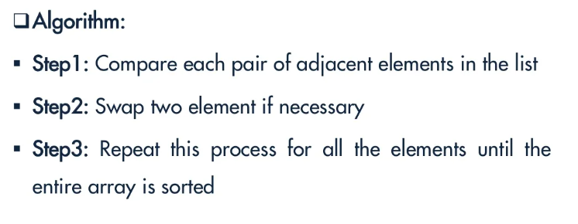
Bubble Sort

Slide 30
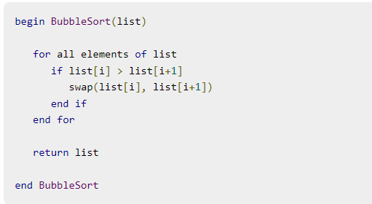
Bubble sort

Slide 31
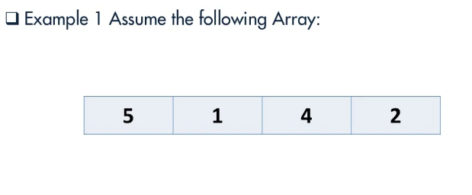
Bubble Sort

Slide 32
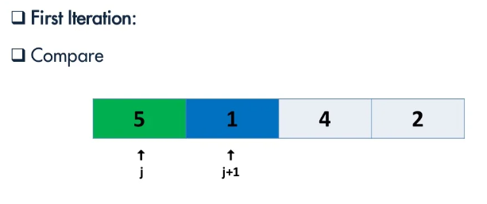
Bubble Sort

Slide 33
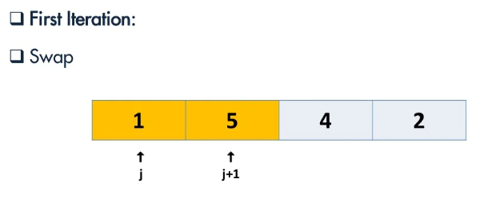
Bubble Sort

Slide 34
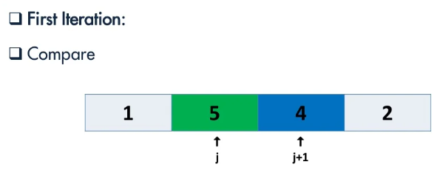
Bubble Sort

Slide 35
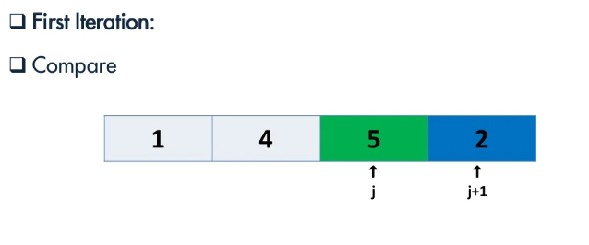
Bubble Sort

Slide 36
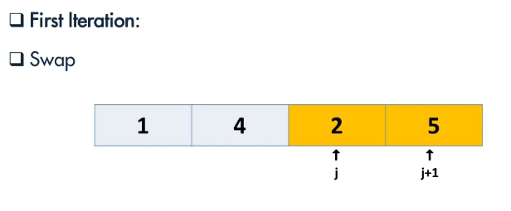
Bubble Sort

Slide 37
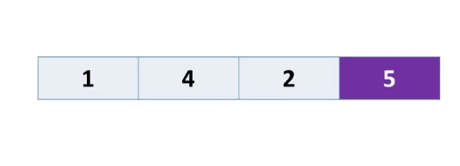
Bubble Sort

Slide 38
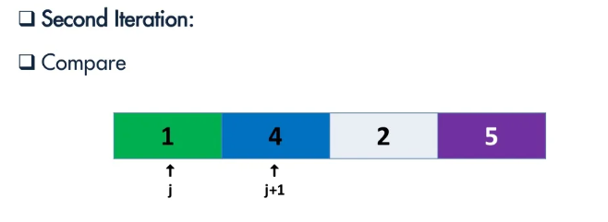
Bubble Sort

Slide 39
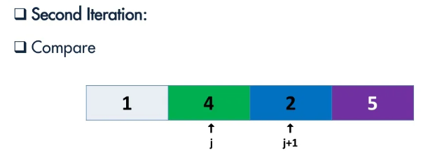
Bubble Sort

Slide 40
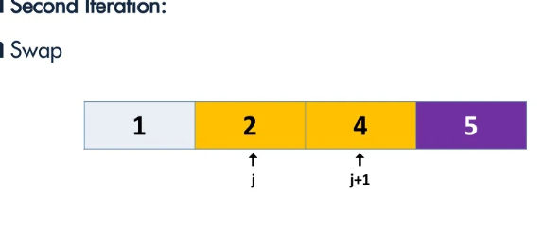
Bubble Sort

Slide 41
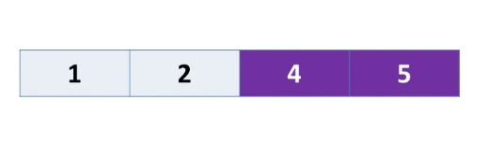
Bubble Sort

Slide 42
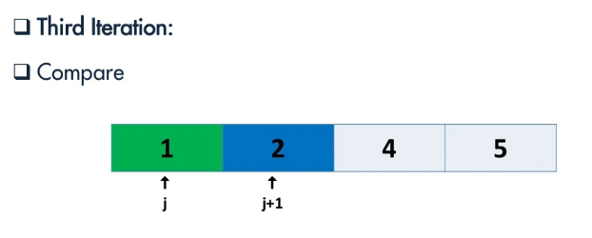
Bubble Sort

Slide 43
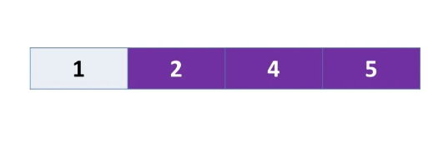
Bubble Sort

Slide 44
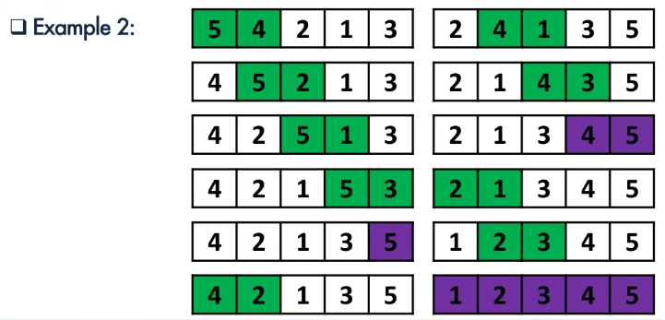
Bubble Sort

Slide 45
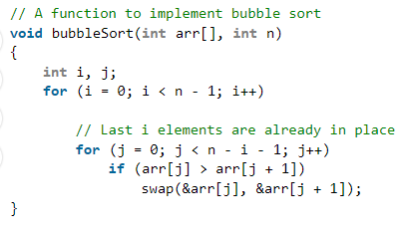
Bubble Sort Algorithm in C

Slide 46
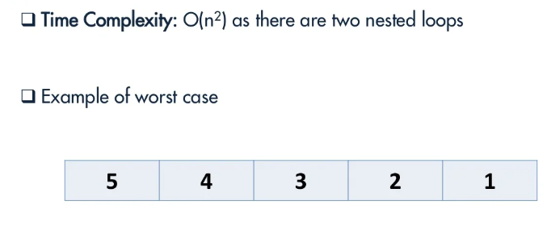
Time Complexity

Slide 47
Time Complexity
This algorithm is not suitable for large data sets as its average and worst-case time complexity is quite high.

Slide 48
Boundary case for Bubble sort
Bubble sort takes minimum time (Order of n) when elements are already sorted. Best case would be O(n).
Hence it is best to check if the array is already sorted or not beforehand, to avoid O(N²) time complexity.

Slide 49
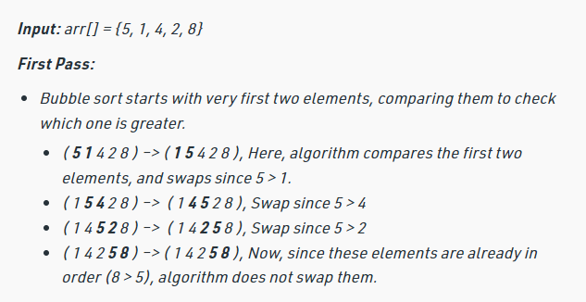
Example 2

Slide 50
